Slide 1

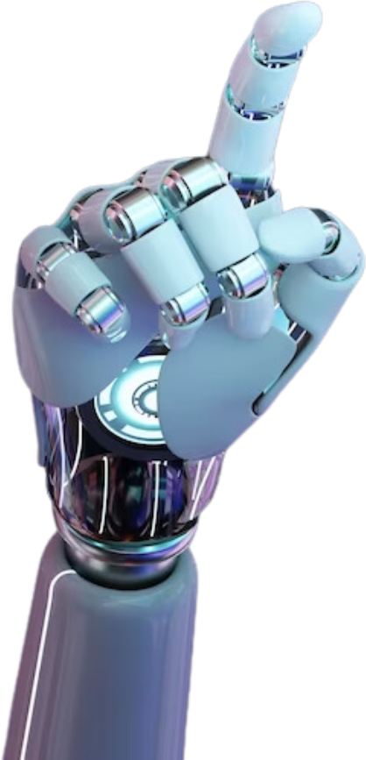
Sign Language Interpreter
Presented by Theyal Dookhy
Student ID: M00927617
Supervisor: Mr Karel

Slide 2
Contents
Introduction
Aim & Objectives
Literature Review
Design & Methodology
Implementation & Testing
Evaluation
Results & Discussion
Conclusion & Future Works
References

Slide 3
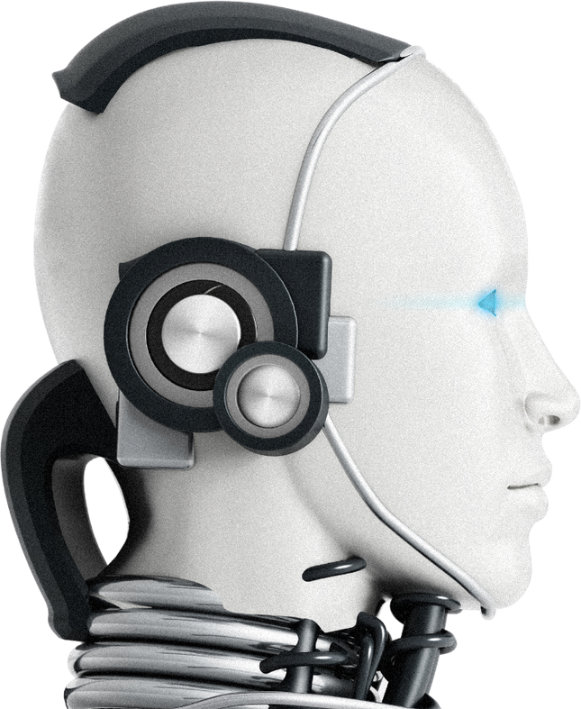
Introduction
Sign language is a visual-manual form of communication that uses hand shapes, movements, facial expressions and body language to convey meaning. It is primarily used by Deaf and hard-of-hearing individuals, but also by people with communication disorders and their communities. (Zhang and Jiang, 2024)
Human interpreters are not always available, particularly in healthcare, education,or emergencies.
High interpreter costs make accessibility difficult in many regions.
AI and Computer Vision (CV) present scalable, cost-effective alternatives for real-time interpretation (Chen et al., 2019).

Slide 4

Aim and Objectives
Aim
Develop a web-based AI sign language interpreter
Objectives
Real-time ASL recognition via webcam
Integrate Learn, Practice and Predict modules
Improve model accuracy with ConvLSTM2D architecture
Accessible and interactive

Slide 5

Literature Review
Vision-Based Models
Sensor-Based Models
Use cameras + CNNs/RNNs for gesture recognition (e.g., SignGPT)
Use wearables or depth cameras (e.g., MotionSavvy) for higher accuracy
Hybrid Systems
Combine both for robustness but increase computational complexity
Dataset Diversity
Continuous Signing
Lack of signer variety, lighting, environment in public datasets
Hard to interpret fluent sign streams
Cultural & Ethical Concerns
Must respect linguistic diversity and involve deaf communities

Slide 6

Design & Methodology
Development Approach
Agile Methodology
Iterative development, continuous testing, feedback-driven refinement
(Mindbowser, n.d.)
System Components
Frontend
Backend
HTML/CSS/JS web UI with Learn, Practice, Predict modules
FastAPI with REST and WebSocket endpoints
FastAPI handles prediction, feedback and model inference
Modeling Pipeline
Data collection → Preprocessing → ConvLSTM2D training → Prediction + Text to Speech

Slide 7

Implementation & Testing
ConvLSTM2D: Learns both gesture shape (spatial) and motion over time (temporal) with dropout, 4 stacked layers, softmax output
Input Structure: 30-frame sequences → landmark extraction → classification via softmax
Model Architecture
Web Application
Testing Strategy
Modules: Learn (tutorials), Practice (quizzes), Predict (live recognition)
Real-Time Integration: WebSocket used for low-latency webcam streaming and predictions
Functional Testing: UI responsiveness, prediction accuracy
Performance Testing: Inference time < 2 seconds
Unit Testing: MediaPipe, preprocessing and model output verified independently

Slide 8

Evaluation
Metrics & Results
Tools Used
Accuracy: 95.48% on validation data
Precision/F1-Score: Most signs scored above 0.90
Latency: Predictions delivered in under 2 seconds
Confusion Matrix: Highlights sign-level misclassifications
User Feedback: Allows corrections to improve future model training
Scikit-learn: For classification reports and performance analytics

Slide 9

Results
Strengths
High Performance: Real-time recognition with strong validation metrics
Accessibility: No special hardware needed—just a webcam and browser
User Engagement: Learn and Practice modules promote interactive use
Limitations
Gesture Ambiguity: Similar signs may be confused
Environment Sensitivity: Lighting and occlusion impact prediction
Generalization: Limited signer diversity affects real-world robustness

Slide 10
Conclusion & Future Works
Working Prototype: Demonstrates feasibility of real-time sign interpretation on web
Inclusive & Scalable: Designed to support accessibility goals and education
Future Works:
Vocabulary Expansion: Add more signs and sentence-level recognition (Camgoz et al., 2018)
Multimodal Fusion: Incorporate facial expressions for improved accuracy (Dimitropoulos et al., 2021)
Continuous Signing: Transition from isolated words to sentence translation
User Personalization: Adapt models to unique signing styles of individual

Slide 11
References
Camgoz, N. C., Koller, O., Hadfield, S., & Bowden, R. (2018). Neural Sign Language Translation, In Proceedings of the IEEE Conference on Computer Vision and Pattern Recognition (CVPR). Available at: https://ieeexplore.ieee.org/document/8578590 (Accessed: 08 February 2025).
Chen, Y., Zhang, X. & Li, L. (2019) Real-time sign language recognition with deep learning: A review. Available at: https://ieeexplore.ieee.org/document/8744292 (Accessed: 10 February 2025).
Dimitropoulos, K., Daras, P. et al. (2021) Deep Learning Methods for Sign Language Translation, Sensors. Available at: https://www.mdpi.com/1424-8220/21/7/2437 (Accessed: 25 January 2025).
Mindbowser. (n.d) Step by step process of Agile Scrum methodology. Available at: https://www.mindbowser.com/step-by-step-process-of-agile-scrum-methodology/ (Accessed: 01 February 2025).

Slide 12

Live Demo

Slide 13
Thank you

